Slide 1
Multi-Agent
Programming Contest
[Agents on Mars]
Research lab – Summer term 2014
University Koblenz-Landau
MAPC

Slide 2
Outline
The Contest
Scenario
Our Strategies
  Agent Specific Strategies
  Zoning Strategy
Implementation Details
Competition Outcome
Lessons Learned
MAPC

Slide 3
The Contest – Aims and Scope
International online competition since 2005
Attempt to stimulate research in the area of multi-agent system development and programming by
  identifying key problems
  collecting suitable benchmarks
  gathering test cases

Slide 4
The Contest
Changing scenarios
  2005: Food Gatherer
  2006-07: Goldminers
  2008-10: Cows and Cowboys
  2011-14: Agents on Mars
Focus: Agent cooperation and coordination. Implementation technology left to participants

Slide 5
Scenario
  In the year 2033 mankind finally populates Mars. While in the beginning the settlers received food and water from transport ships sent from earth shortly afterwards - because of the outer space pirates - sending these ships became too dangerous and expensive. Also, there were rumors going around that somebody actually found water on Mars below the surface. Soon the settlers started to develop autonomous intelligent agents, so-called All Terrain Planetary Vehicles (ATPV), to search for water wells. The World Emperor - enervated by the pirates - decided to strengthen the search for water wells by paying money for certain achievements. Sadly, this resulted in sabotage among the different groups of settlers.

Slide 6
Scenario
Challenge:
  Find valuable water wells and occupy the best zones
  Attack rivals and defend against attacks
  Earn money/achievement points (milestones, as 5 successful attacks)
Goal: maximize the score (points for zones plus achievement points)

Slide 7
Scenario - Environment
Weighted graph
  Weighted edge: costs of traversing this edge
  Labeled node: value of this water well
Graph is unknown at the beginning
  Neither the costs of traversing an edge nor the value of a node are known
  Agents must explore the graph

Slide 8
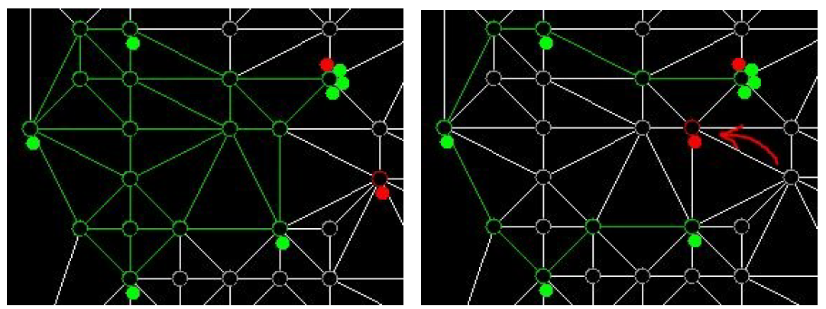
Scenario – Occupying Zones/ Graph coloring algorithm

Slide 9
Scenario - Agents
Attributes
  Energy, Health, Strength, Visibility Range
(Ranged) Actions
  Probe, Survey, Goto, Inspect, Attack, Parry Buy
Five different roles (‘experts’):
  Explorer, Saboteur, Sentinel, Repairer, Inspector

Slide 10
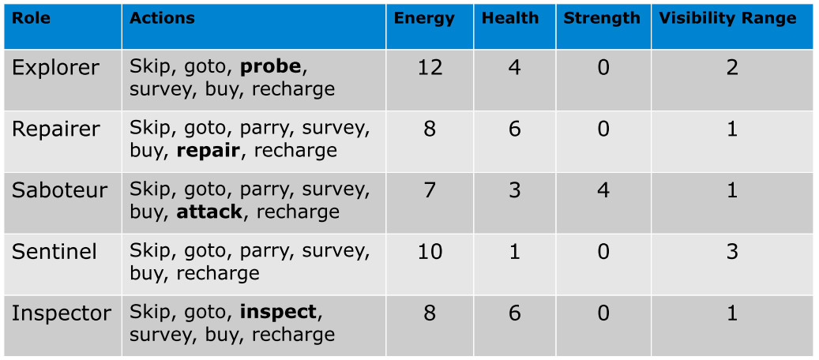
Scenario - Agents

Slide 11
Scenario - Agents
Agents run on participant's infrastructure
Simulated environment runs on a remote server
Agents communicate with the server by exchanging XML messages
After each simulation step the server delivers new percepts on which the agents then can reason on

Slide 12
Our Strategies
Two overall phases: exploration & zone mode
We start with exploring the graph
After that all agents switch to zone mode
Applies to all agents except saboteurs (we chose to be as aggressive as possible)

Slide 13
Our Strategies - Exploration
Before we start with building zones, the graph needs to be explored (DFS)
In this phase Inspectors, Repairers, Sentinels perform survey action to retrieve the edge weights of this node
Explorers perform probe action before surveying
Surveyed/probed nodes are stored in order to not survey a node twice

Slide 14
Our Strategies – Zone Mode
Once there are no unsurveyed nodes anymore, agents switch to zone mode
Each node agent calculates his best zone (2-hop neighbors)
Best means highest zone value with minimal number of agents.
Agents register for zoning
Ask for best zone

Slide 15
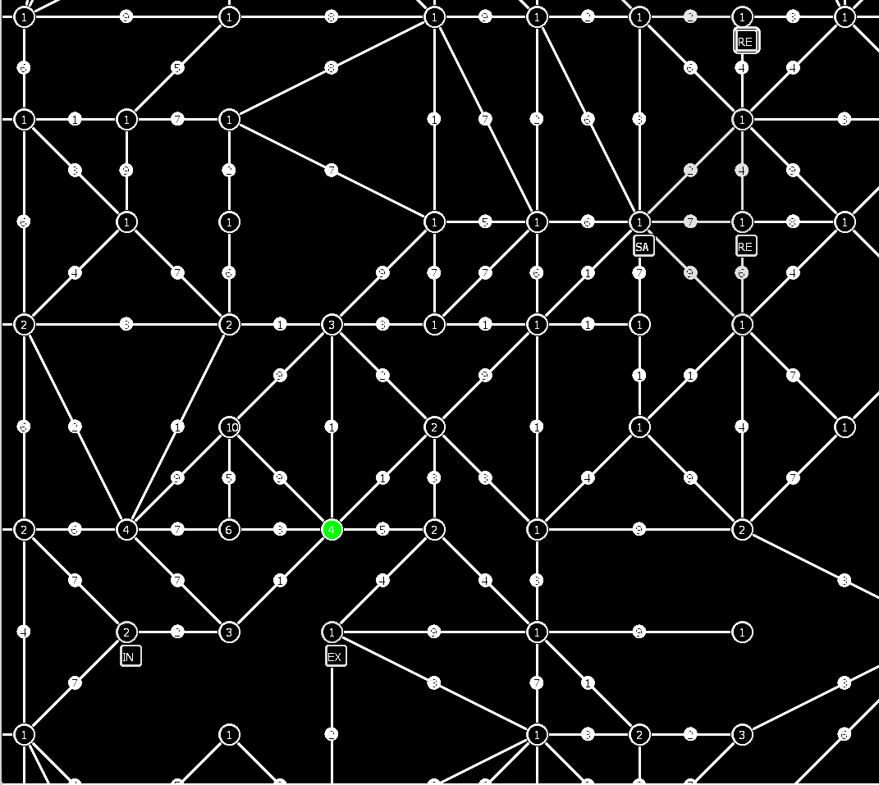
Our Strategies – Zone Calculation

Slide 16
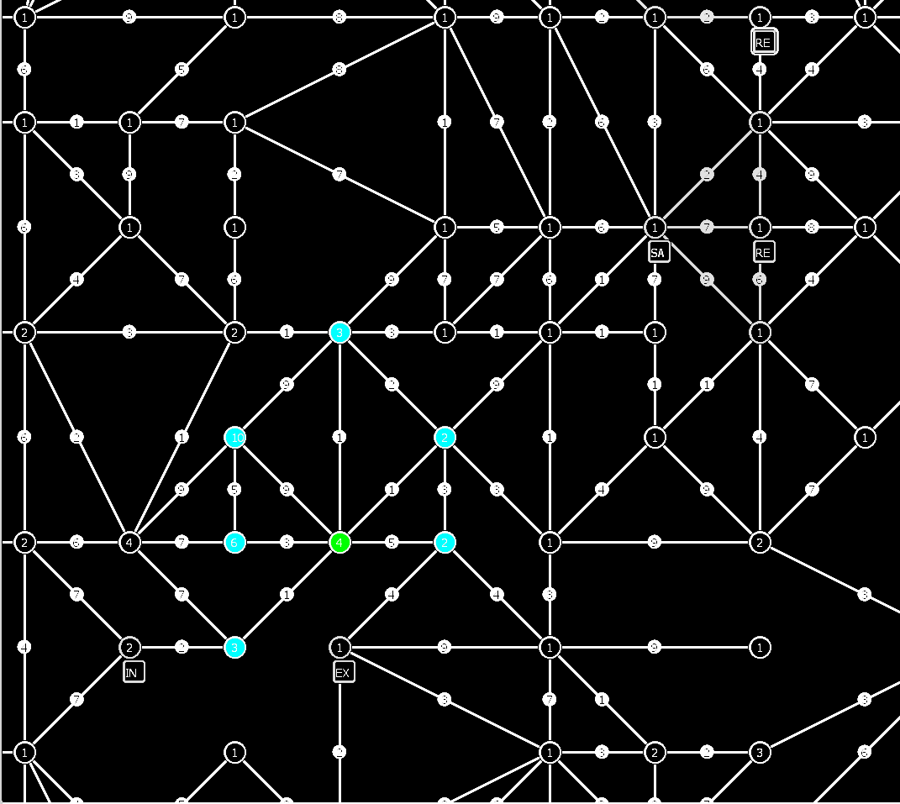
Our Strategies – Zone Calculation

Slide 17
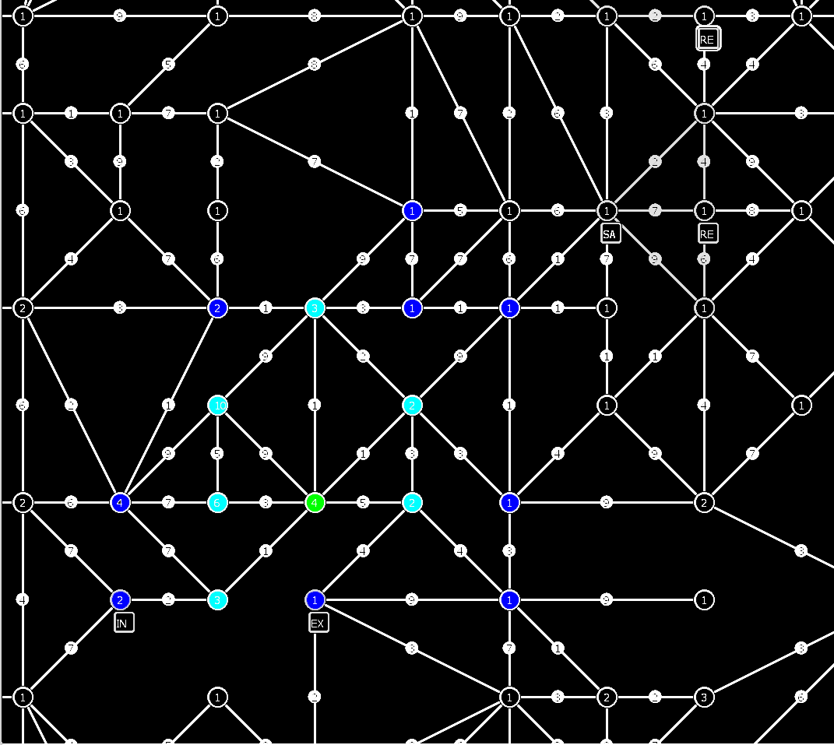
Our Strategies – Zone Calculation

Slide 18
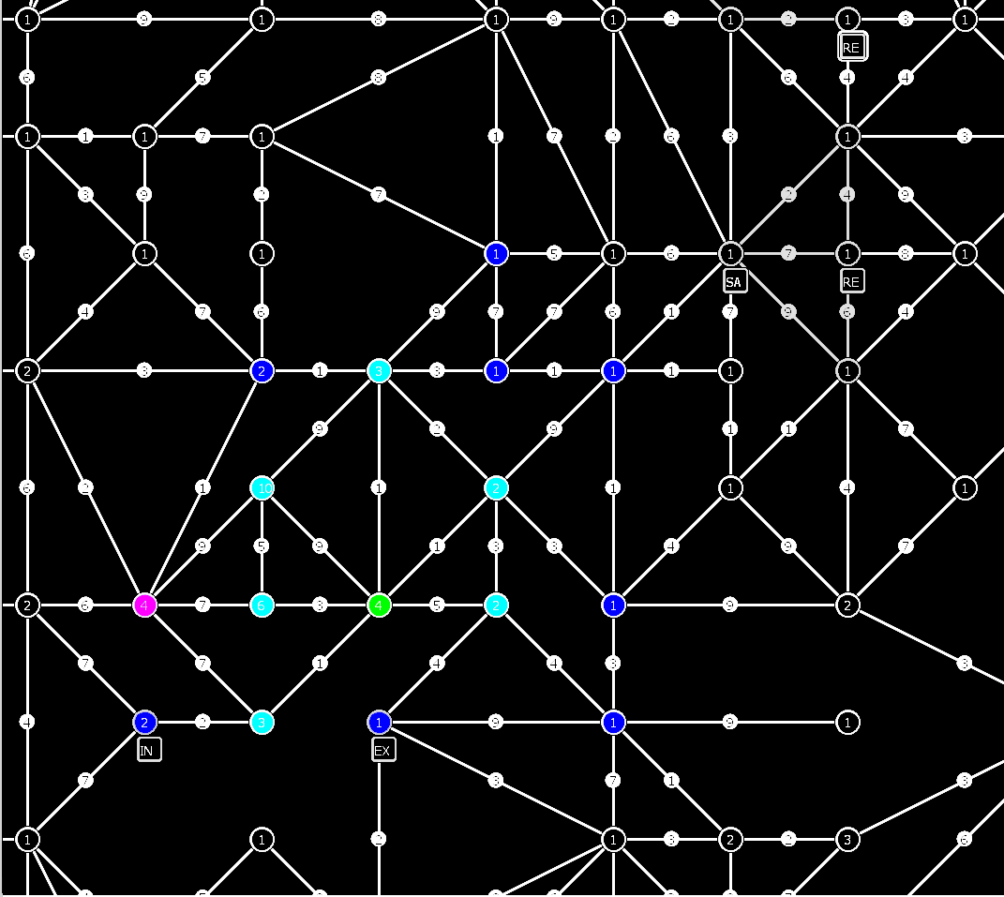
Our Strategies – Zone Calculation

Slide 19
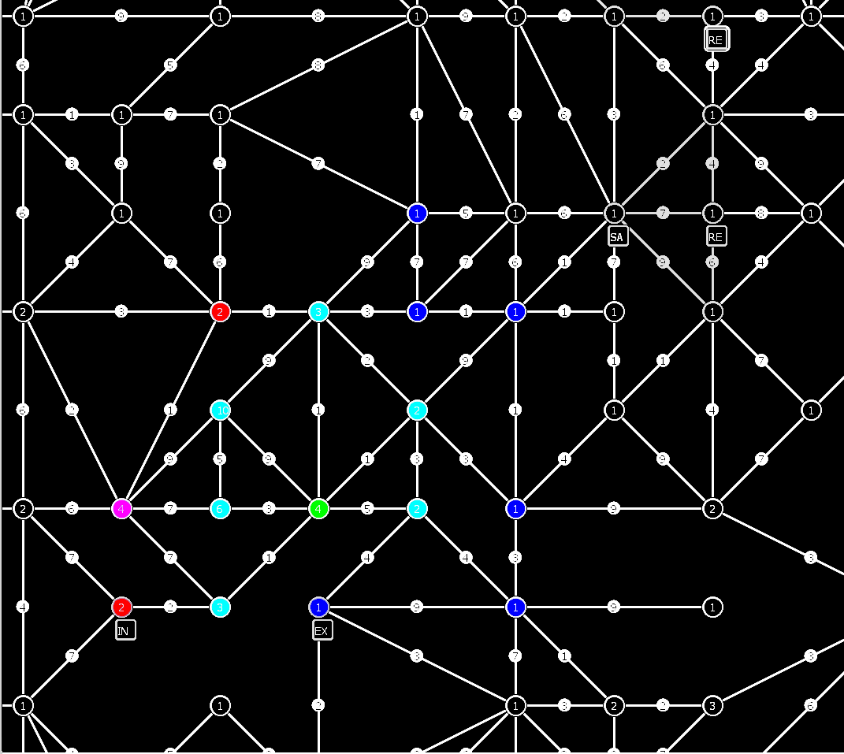
Our Strategies – Zone Calculation

Slide 20
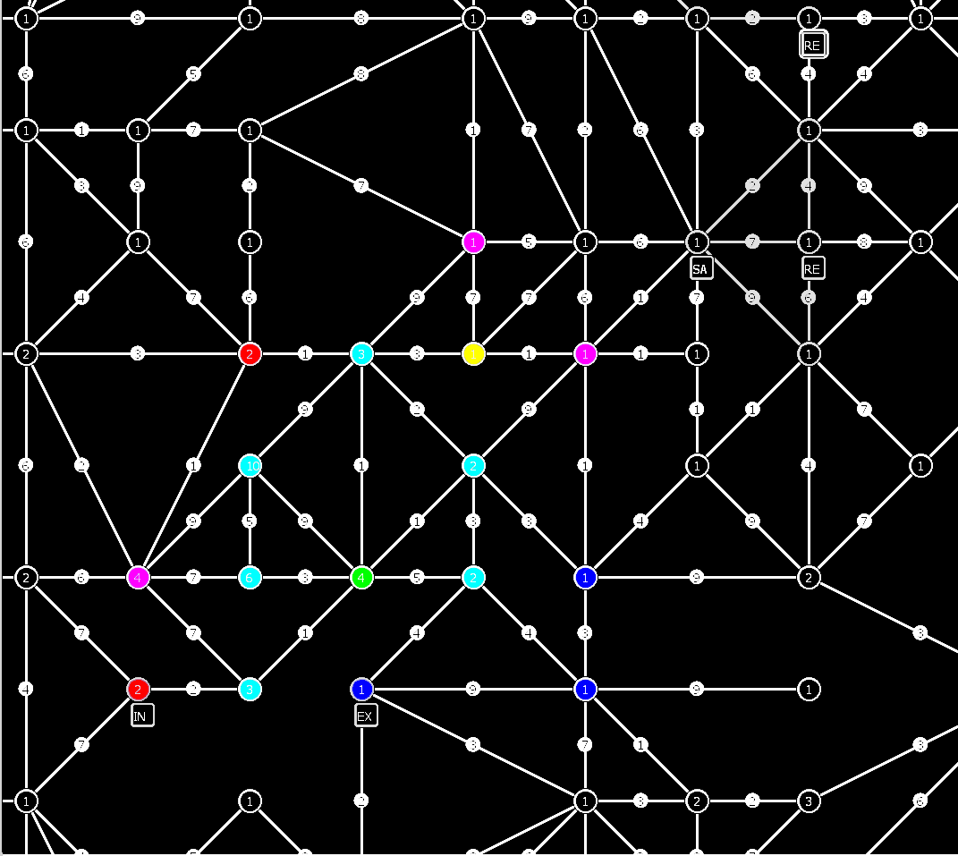
Our Strategies – Zone Calculation

Slide 21
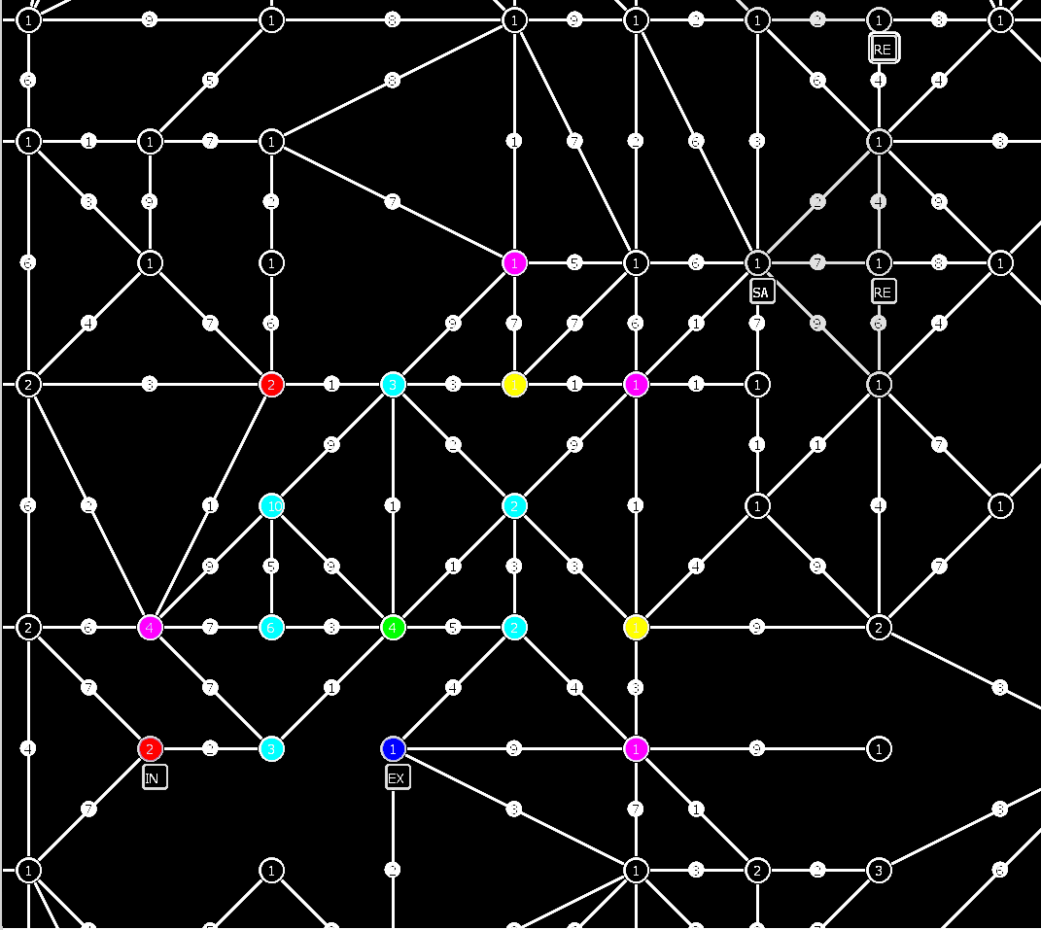
Our Strategies – Zone Calculation

Slide 22
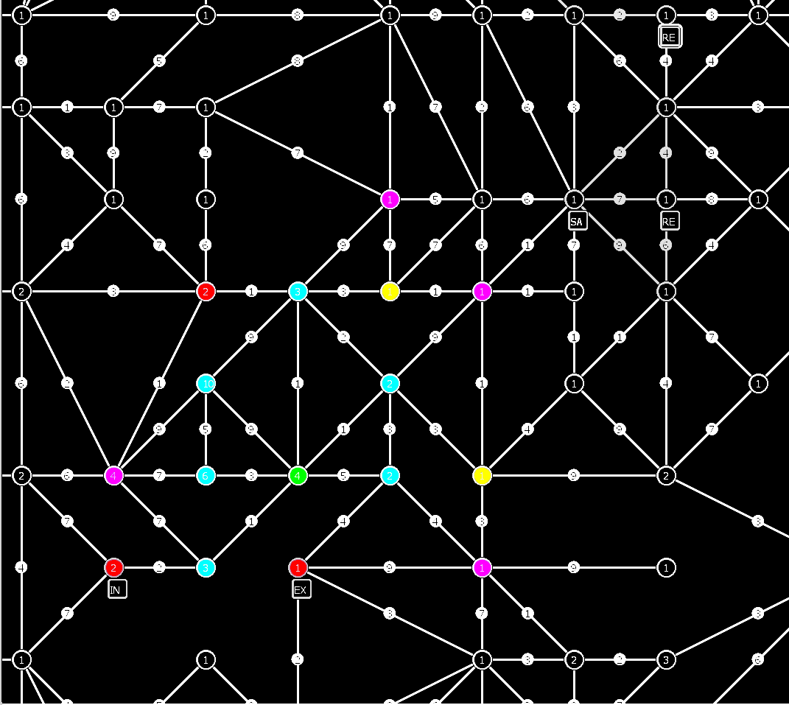
Our Strategies – Zone Calculation

Slide 23
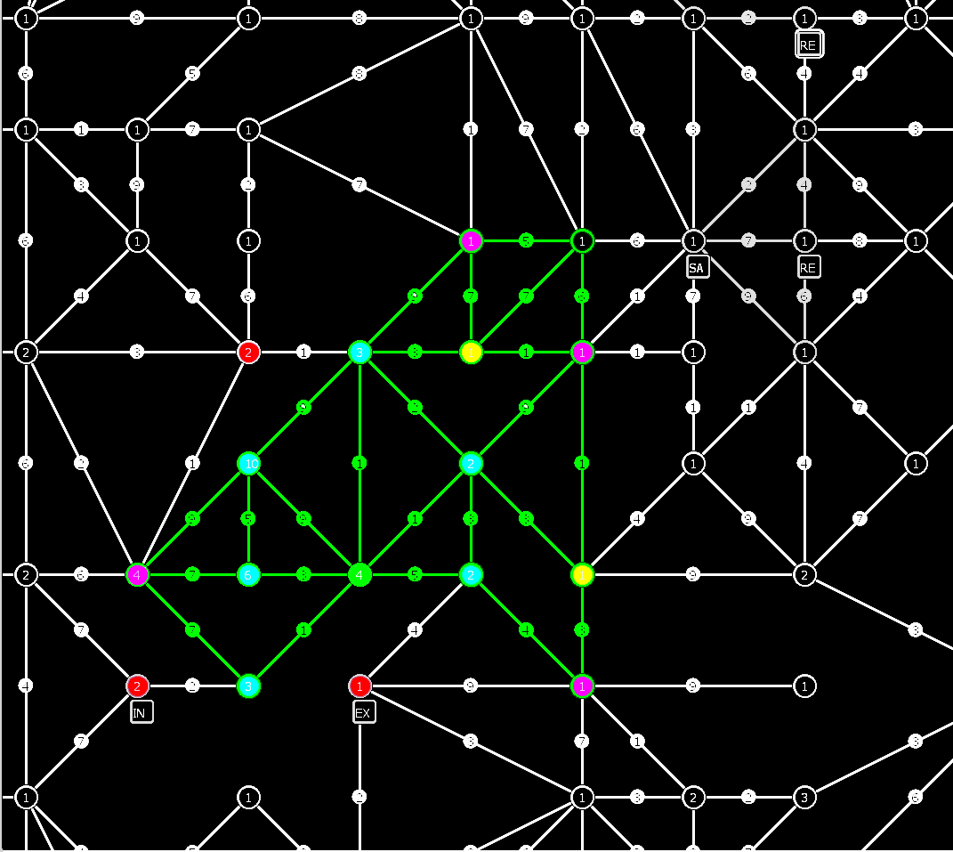
Our Strategies – Zone Calculation

Slide 24
Our Strategies – Zone Mode
If there are enough agents (zoner) available for zoning do the following:
  communicate every zone to every zoner
  best zone is picked
  use closest zoners to build best zone
  all participants of the zone are removed from available zoners
If not: agent goes to highest value node

Slide 25
Our Strategies – Explorer Strategy
Probe in clusters/circles
  closest vertex with most already probed neighbors

Slide 26
Our Strategies – Saboteur Strategy
Defend established zones
Attack closest enemy agent
We had one ‘artillery agent’ which upgrades his visibility range every time it does not see an enemy agent

Slide 27
Our Strategies – Repairer Strategy
Respond to calls for help -> repair disabled agents
If an agent gets disabled he calls the closest repairer
After repairing continue with zoning

Slide 28
Implementation details
Programming language: Jason, a combination of Java and AgentSpeak
IDE: Eclipse with Jason plug-in
Plans (reasoning and execution of actions) were implemented in AgentSpeak
Computational intensive tasks and storing of graph related percepts in Java objects (interaction between Java and AgentSpeak via internal actions)

Slide 29
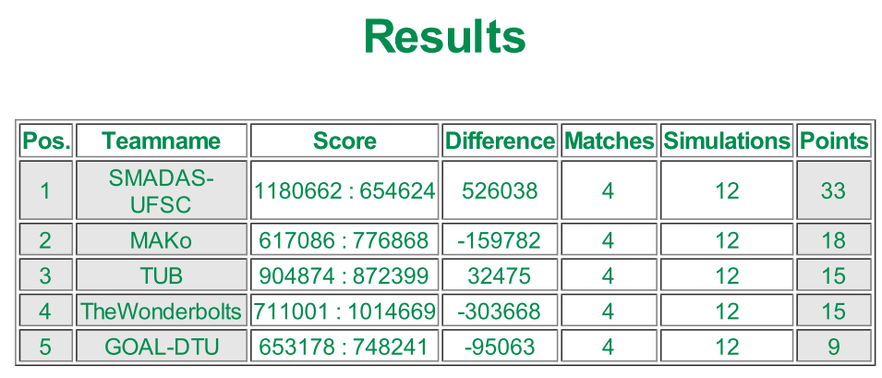
Competition outcome
Team MaKo scored 2nd
The team from the USFC won three times in a row now

Slide 30
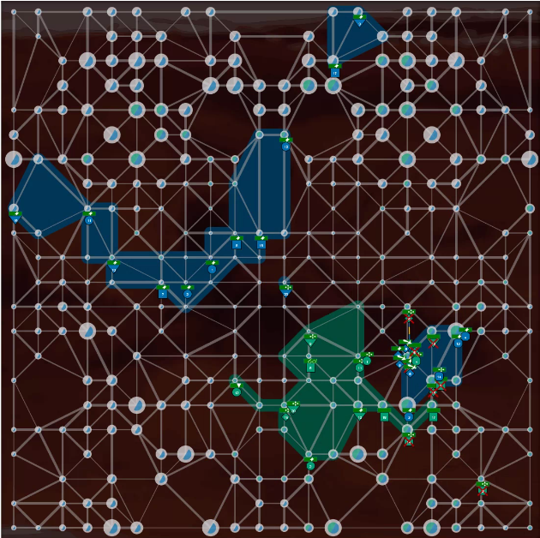
Competition outcome - Visualization

Slide 31
Lessons Learned
Communication between agents in Jason was a extreme bottleneck
Recursion is very slow/computational intense in Jason
When a dash appears in a Term it is interpreted as a number

Slide 32

End Of Presentation
Thanks for your attention!
MAPC

